Slide 1

Happy Birthday My Beloved Wife, I wish you all the success and happiness for the lifetime.
I Hope You Like My Attempt To Express My Feelings For You.

Slide 2
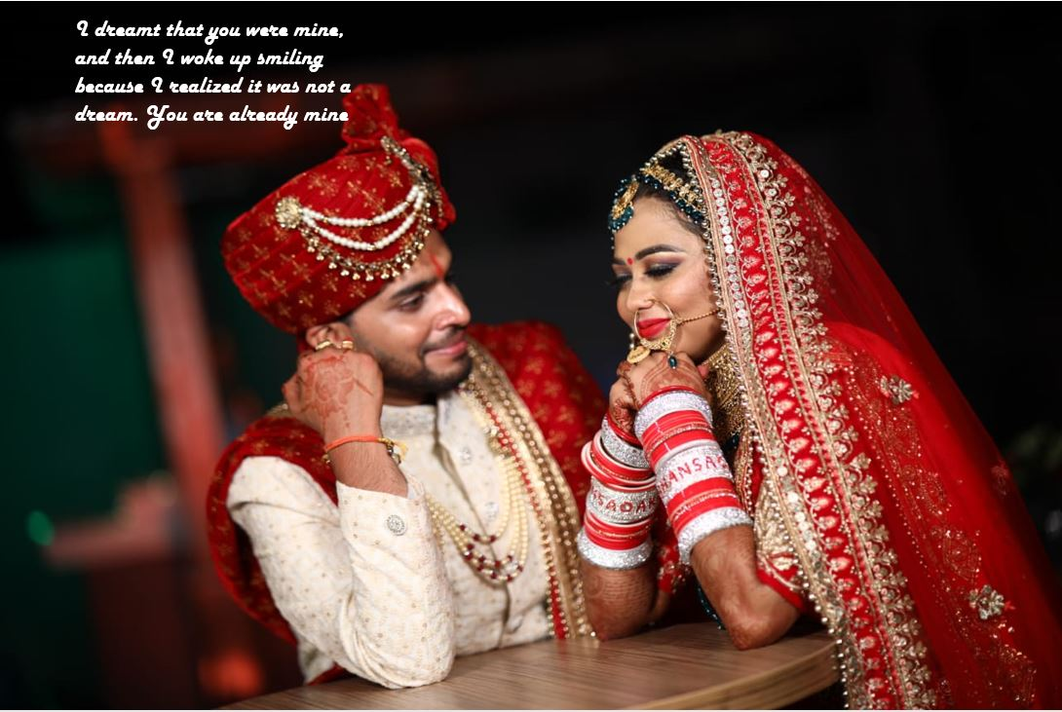

Slide 3
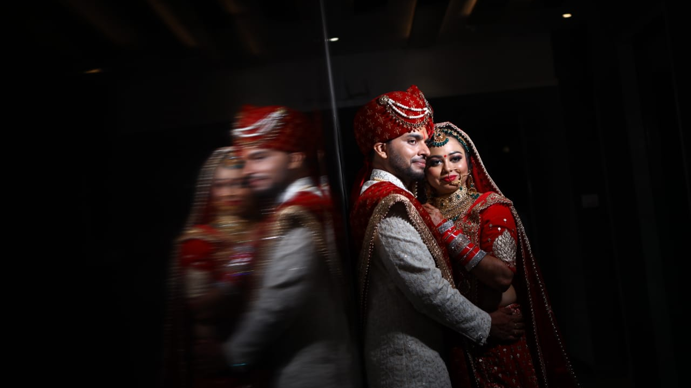
A successful marriage requires falling in love many times, always with the same person

Slide 4
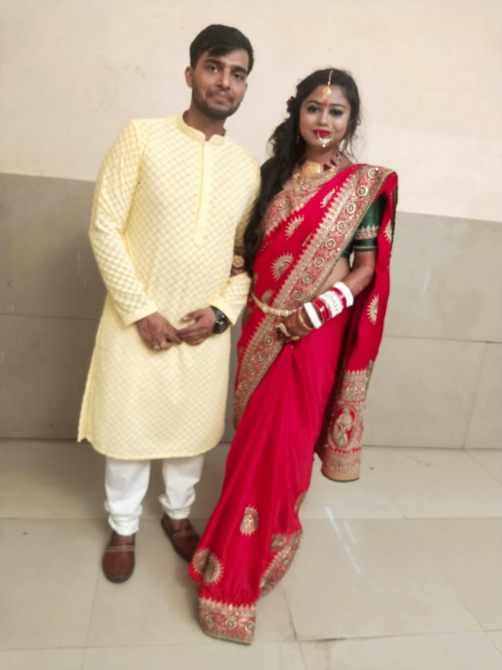
To love is nothing. To be loved is something. But to be loved by the person you love is everything

Slide 5
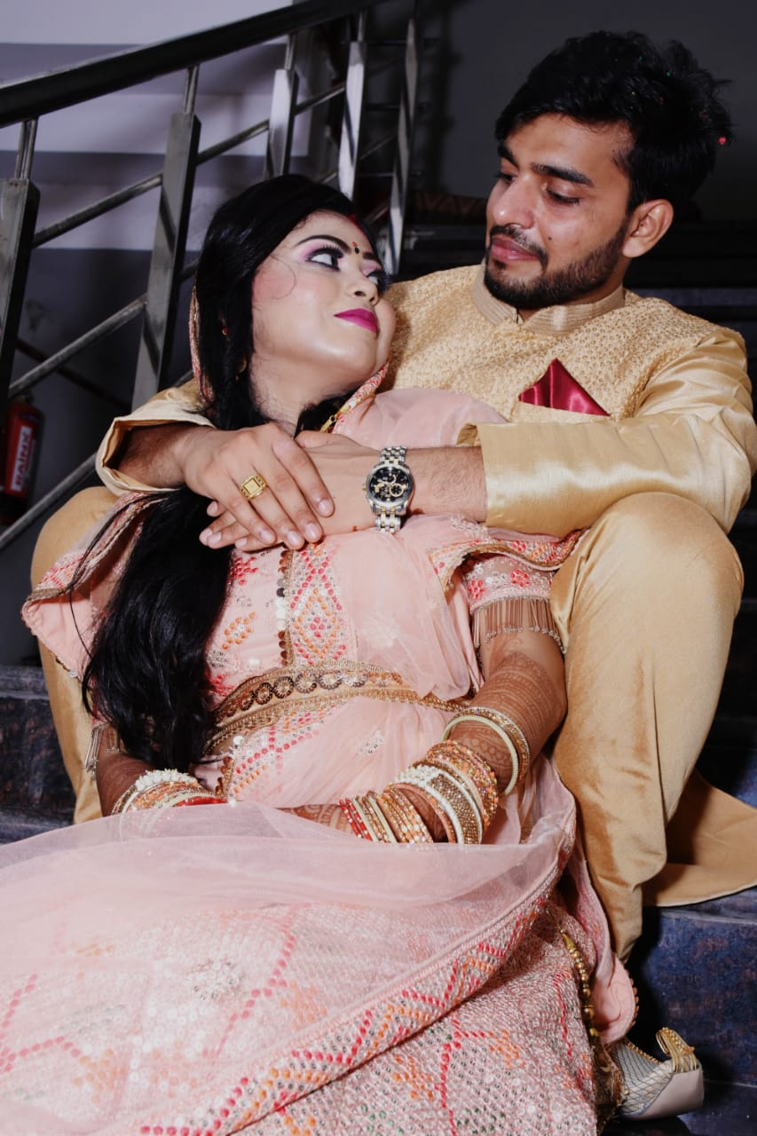
Every time I look into your eye, I get a feeling of completeness. I feel such calmness and Joy which cannot be explained in words.

Slide 6
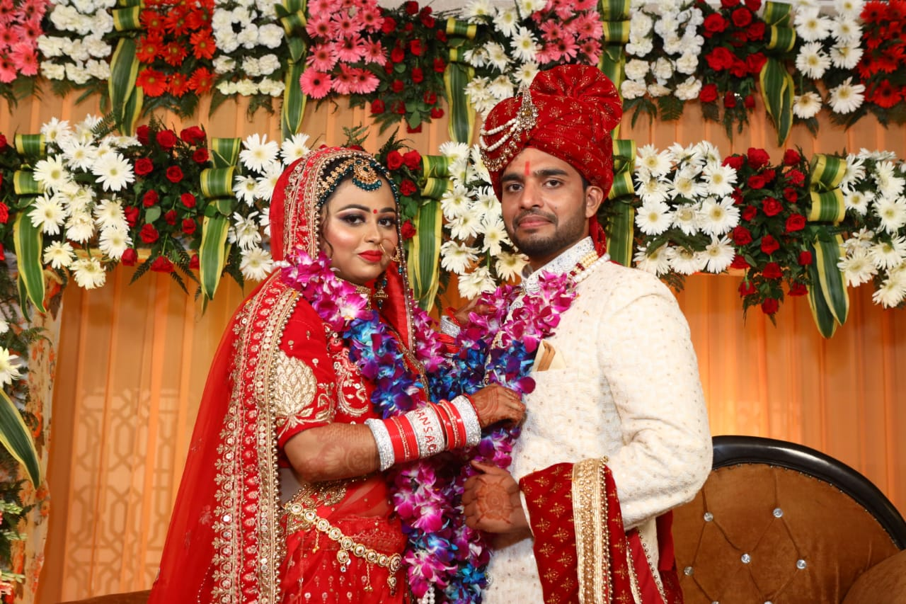
Happy is the man who finds a true friend, I am far happier as I found a true friend in my wife.

Slide 7


In your smile I see something beautiful than moon and stars. Keeping smiling like this forever.
I LOVE YOU

